Slide 1
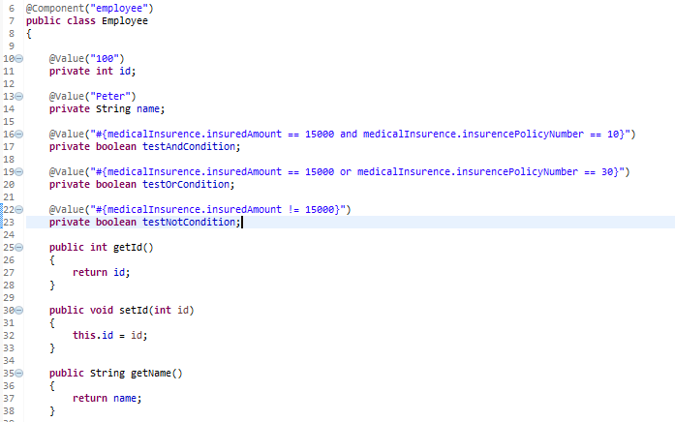
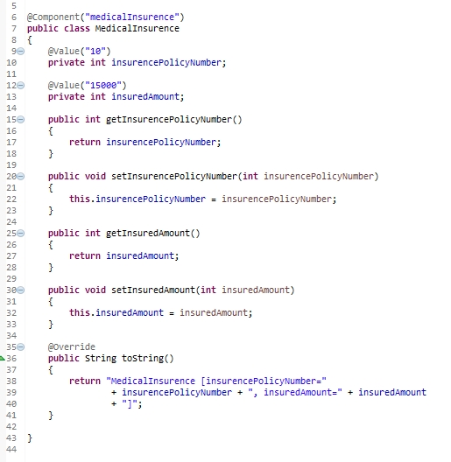

Spring EL Logical operators
Spring EL supports Logical operators – and, or, and not (!).
…
…

Slide 2
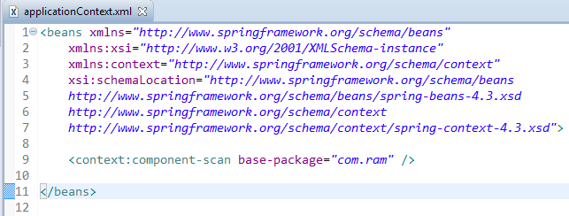
Enable auto component scanning.

Slide 3
